Slide 1
The Final Last Cut Waltz
Being Good Citizens in a World of Data

Slide 2
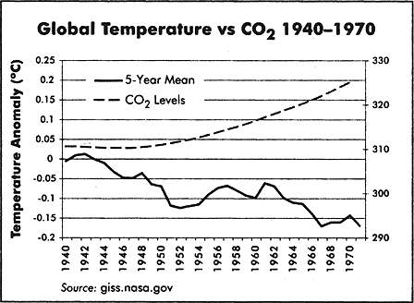

Slide 3
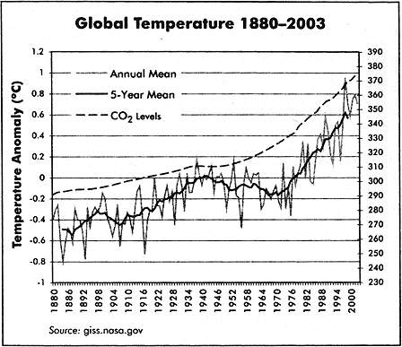

Slide 6
What’s The Message Here?
Correlation Does Not Equal Causation
More Temperature Data
Will not necessarily fix this
Does help with modeling
Think extra-globally
What do we know about CO₂
What do we know about climatic history?

Slide 7
How Can We Test Theories When Experiments Aren’t Practical
Einstein knew how.

Slide 8

Technically this is not an experiment
Why is it so powerful?

Slide 9

The Prediction Was Risky!
The predictions were precise
Failure was clear and well defined
Newtonian physics also predicted deflection
But only by half as much
Is relativity proven?

Slide 10

Be Skeptical
Oh, people can come up with statistics to prove anything, Kent. 14% of people know that.
-Homer Simpson-

Slide 11
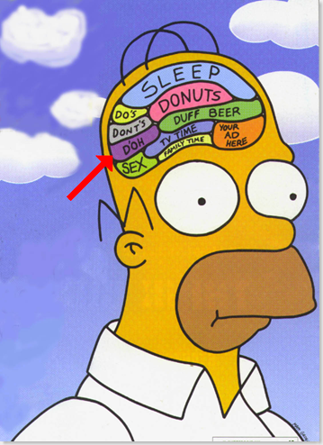
But Don’t Be Homer
"Oh, Lisa, you and your stories: Bart's a vampire, beer kills brain cells. Now let's go back to that... building... thingie... where our beds and TV... is."

Slide 12
Pay Attention to First Principles
Does it make sense?
Ideally you have
Previous evidence
Sound Theory
Basic Principles
NOT – would I like to believe it.
How Does It Compare to Competing Theories?
Are they all testable?
What evidence do the other theories enjoy?
(Sorry, divine intervention is not allowed)
Nor is arguments about financial cost

Slide 13
How Big Is Your Data?
My Data Is Bigger Than Your Data?

Slide 14
Top 10 Databases in 2010
World Data Centre for Climate (6.2 PB)
National Energy Research Scientific Computing Center (2.6 PB)
AT&T (323 TB)
Google (91 million searches, 50% of searches)
Sprint (2.85 Trillion Records)
ChoicePoint (250 TB)
YouTube (45 TB)
Amazon (42 TB)
Central Intelligence Agency (?? How does he know?)
Library of Congress (20TB)
What is the correct way to compare this?
Volume?
Objects?
Impact?
How much data world wide?

Slide 15
The Top 10 Databases account for
0.0034% of Global Storage
Big Data Really Isn’t That Big
But the problem is interesting
How do we link all this data together?

Slide 16

Big Impact of Small Data
http://www.youtube.com/watch?v=heaK44PW5ko&feature=g-all-s&context=G263cc50FAAAAAAAAAAA
http://stevekochscience.blogspot.com/2011/02/open-data-success-story.html
http://www.kochlab.org/files/Passivation/

Slide 17
What Steve Does
Right
Wrong
Generate High Quality Data
Release data in a timely manner
Gives lots of background
Uses social media
Lack of metadata (formal)
Data is difficult to navigate
Limited sys-admin

